Slide 1
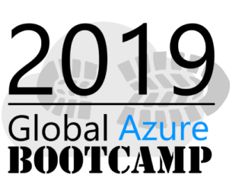








Sponsors for Azure Bootcamp

Slide 2
Getting Started with Machine Learning using Spark in Azure HDInsight
Ingyu Lee
Troy University
https://github.com/Azure-Bootcamp-Troy/GettingStartedMLSparkHDInsight

Slide 3
Content
What is Spark on HDInsight?
Demo: Create Spark Cluster on Azure
What is an RDD, DataFrames, Spark SQL?
Demo: Operations of RDD, DataFrames and SQL
What is MLlib?
Demo: Machine Learning using Spark
For Whom this talk
Business users to analyze Big Data using Spark on Azure Cluster.
Prerequisite
None

Slide 4
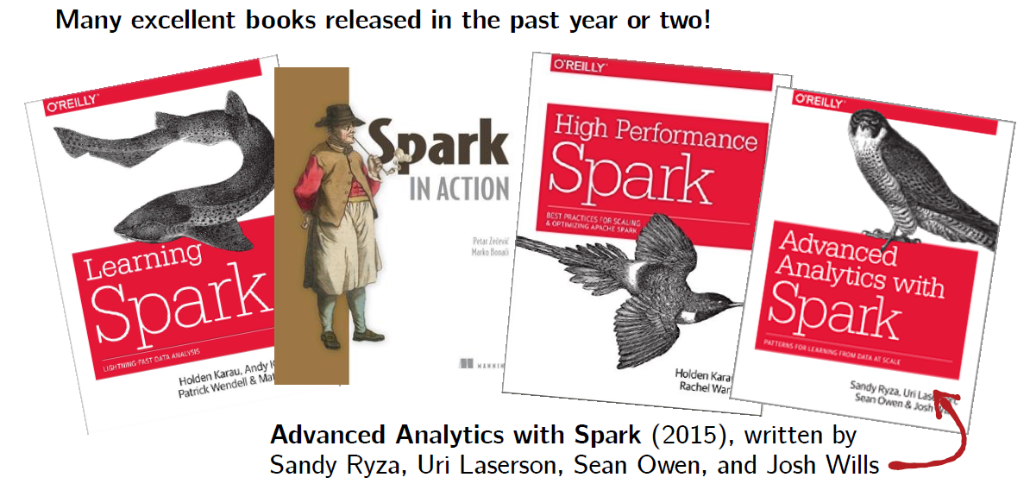
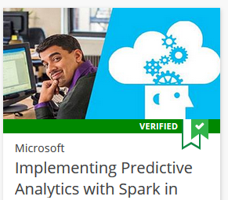
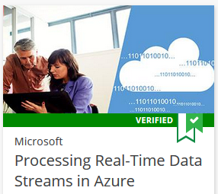
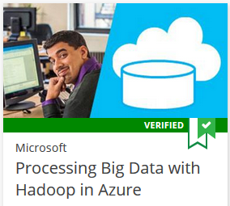
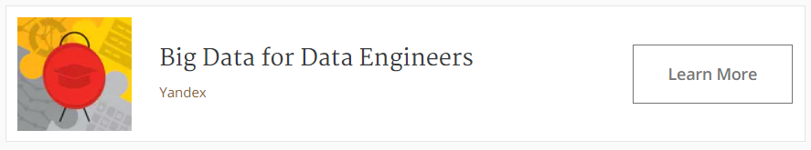
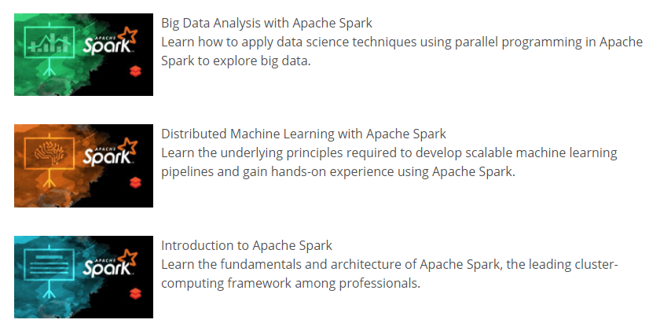
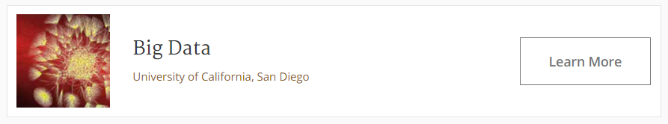
References
This talk is based on this course

Slide 5
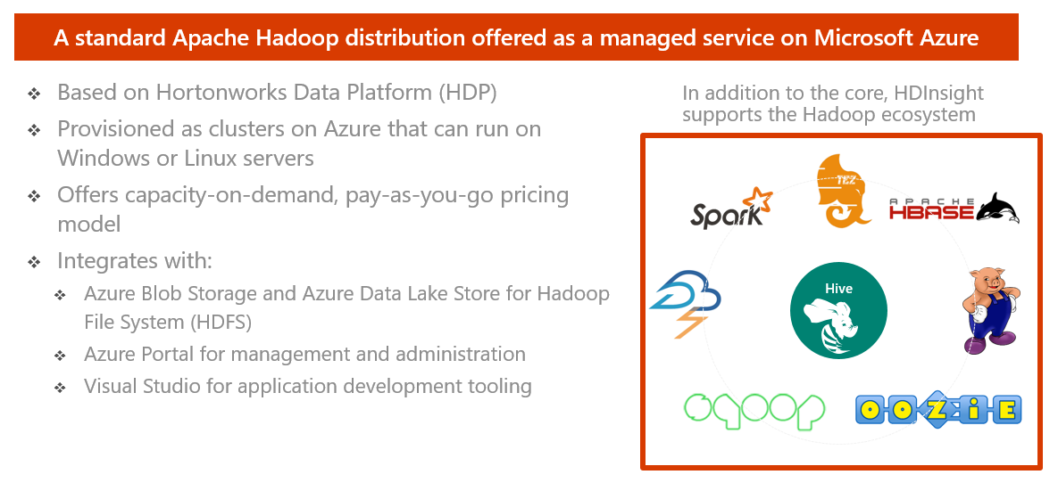
HDInsight – What is it?

Slide 6
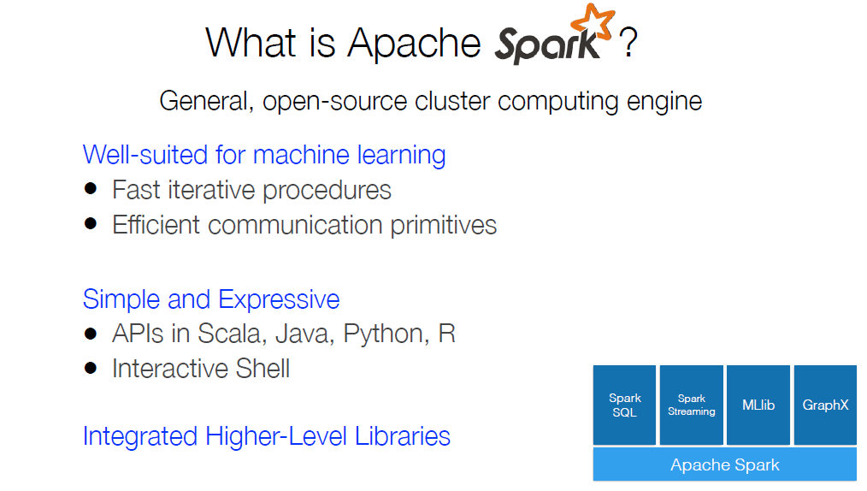
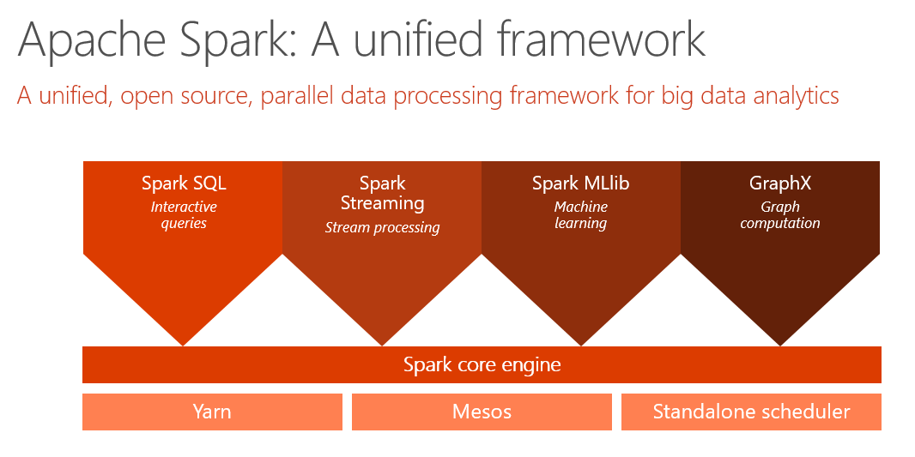

Slide 7
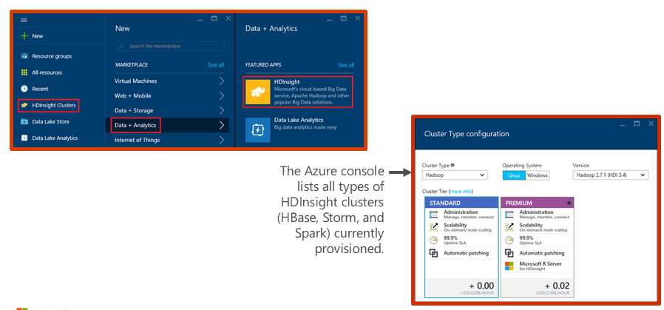
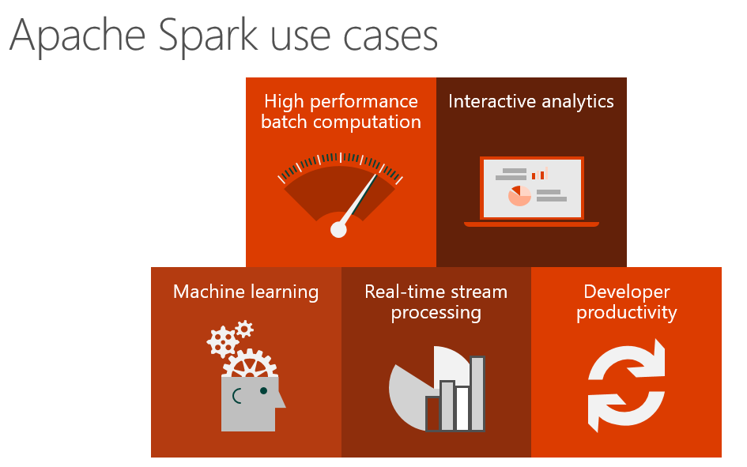
Demo: Creating an HDInsight Spark cluster

Slide 8
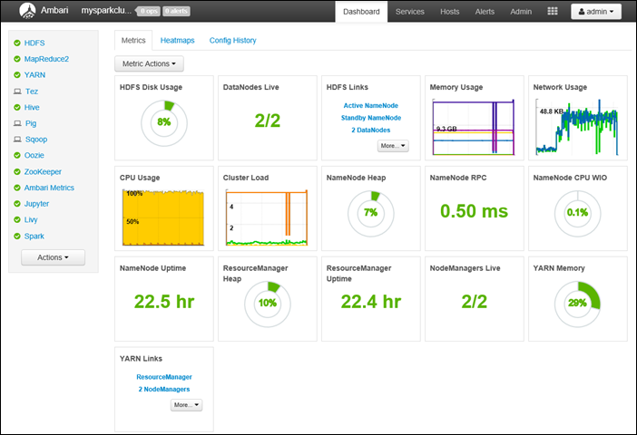
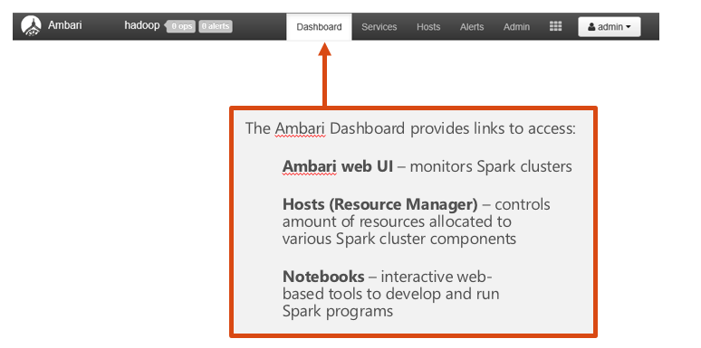
Demo: Ambari Dashboard

Slide 9
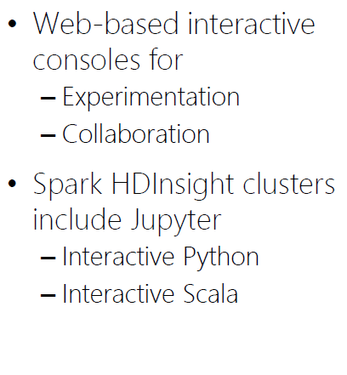
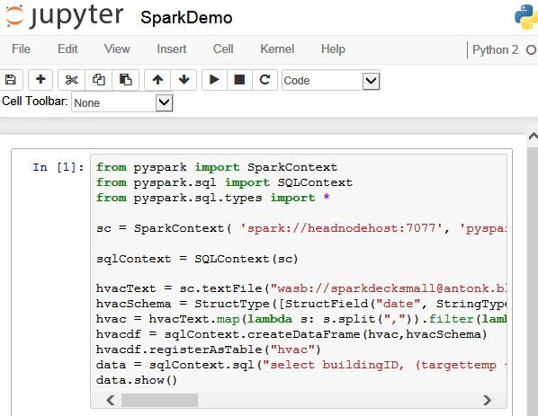
Demo: Jupyter notebooks

Slide 10
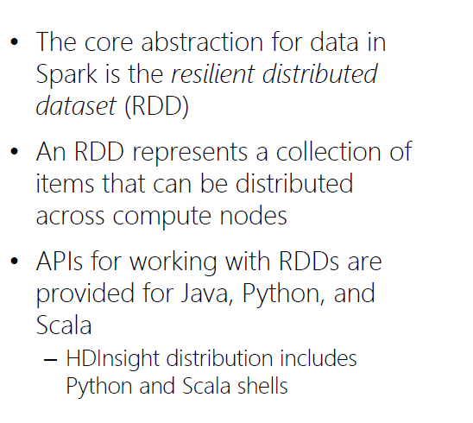
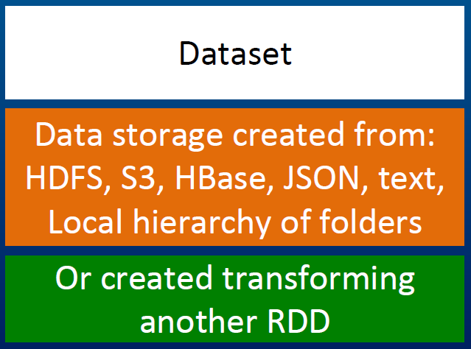
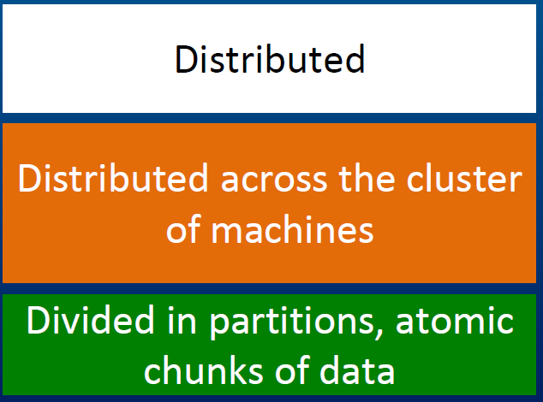
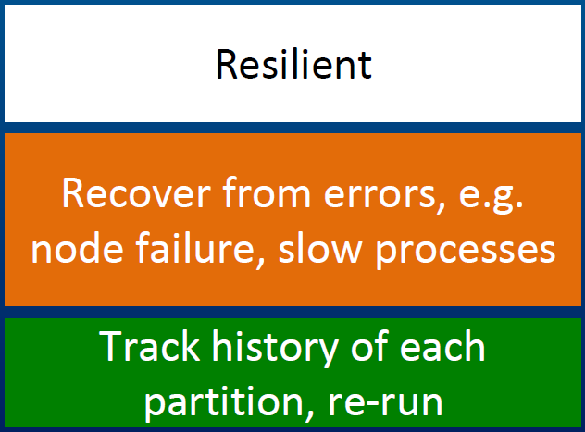
What is RDD?
Resilient Distributed Datasets or RDDs address this by enabling fault-tolerant, distributed, in-memory computations.

Slide 11
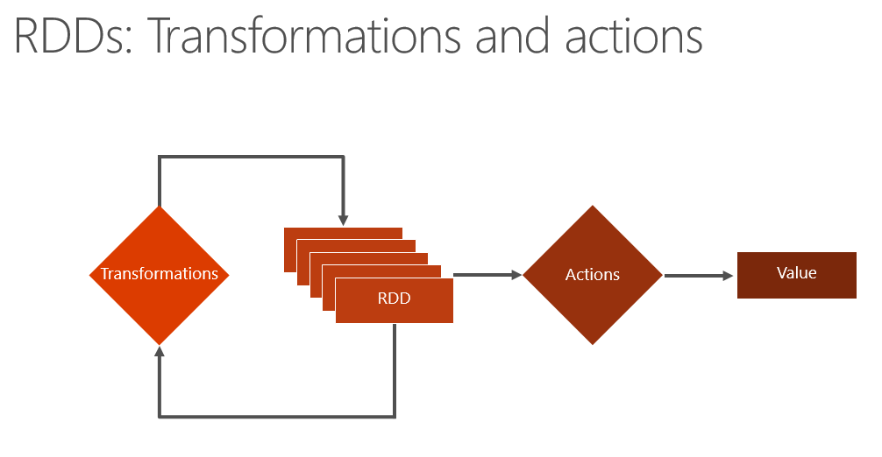
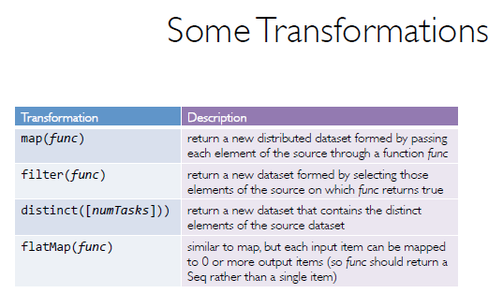
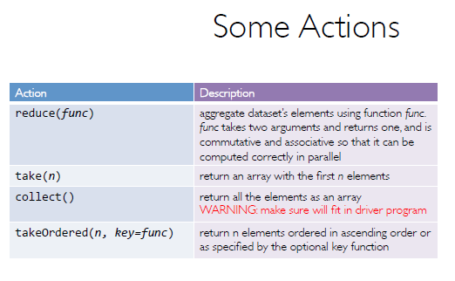
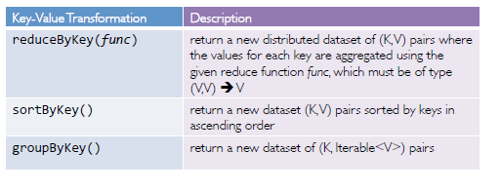
RDD Operations

Slide 12
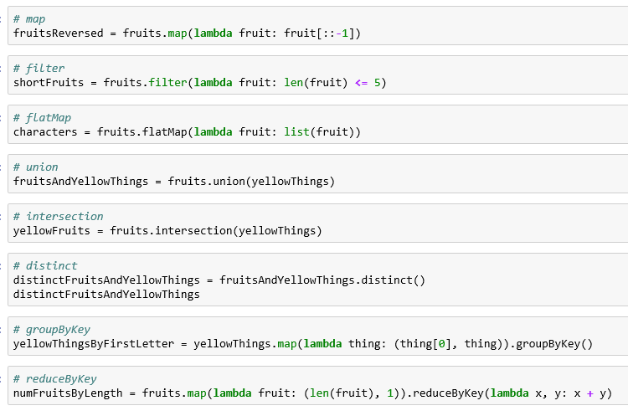
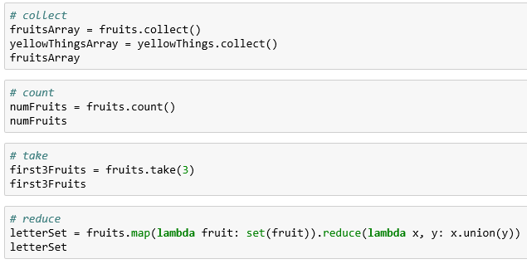
Demo: RDD
RDDs can be created from stable storage or by transforming other RDDs.
Transformations create a new dataset from an existing one. Transformations are lazy, meaning that no transformation is executed until you execute an action.
Actions return a value to the driver program after running a computation on the dataset.

Slide 13
What is DataFrames?
A distributed collection of data organized into named columns.
Similar to RDDs with schema.
Conceptually equivalent to tables in relational database, or to DataFrames in R/Python.
With domain-specific functions designed for common tasks:
Metadata
Sampling
Project, filter, aggregation, and join
UDFs
RDDs are a collection of opaque objects (such as internal structures unknown to Spark).
User
User
User
User
User
User
DataFrames is a collection of objects with schema that are known to Spark SQL..
Name
Age
Sex
Name
Age
Sex
Name
Age
Sex
Name
Age
Sex

Slide 14
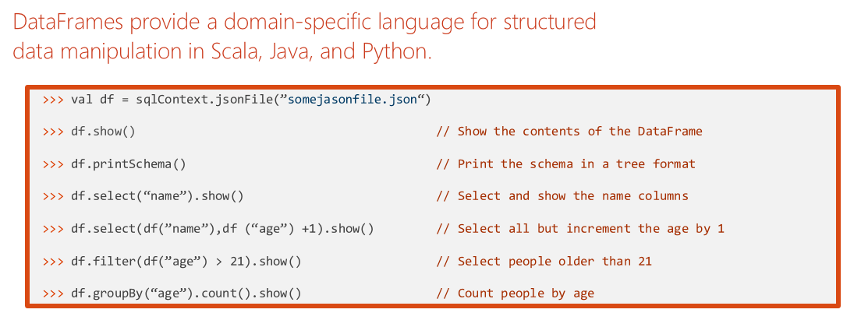
DataFrame Operations

Slide 15
What is Spark SQL?
Create an Azure storage account
HDInsight makes Apache Spark available as a service in cloud.
Run Spark SQL statements using notebooks
1
2
3
HDInsight uses Azure Blob storage account for storing data.
HDInsight makes Apache Spark available as a service in cloud.
You run interactive Spark SQL statements using notebooks.

Slide 16
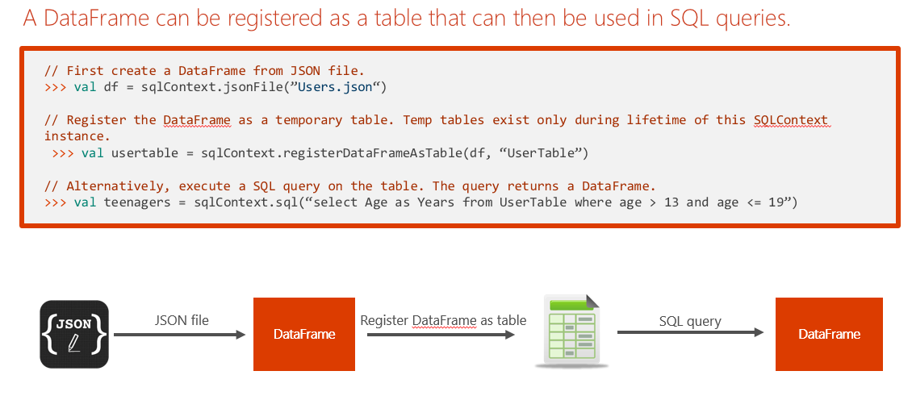
Tables and Queries

Slide 17
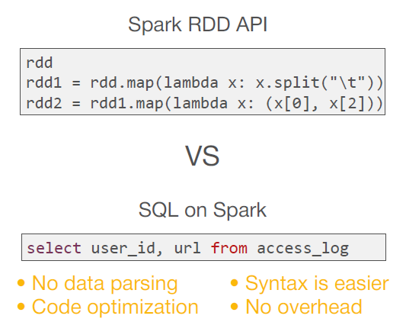
Spark SQL Operations

Slide 18
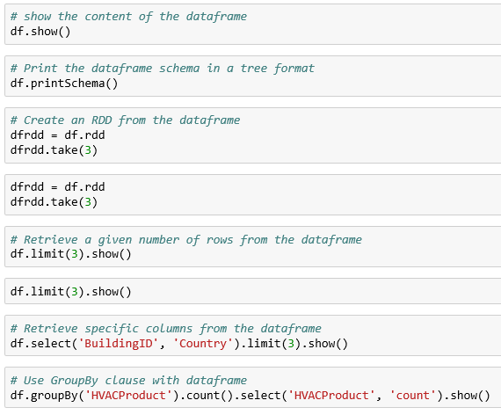
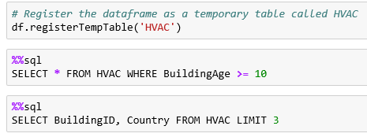
Demo: DataFrame and SQL
create a dataframe from a CSV file as shown below.
run SQL queries over dataframes once you register them as temporary tables within the SparkSession

Slide 19
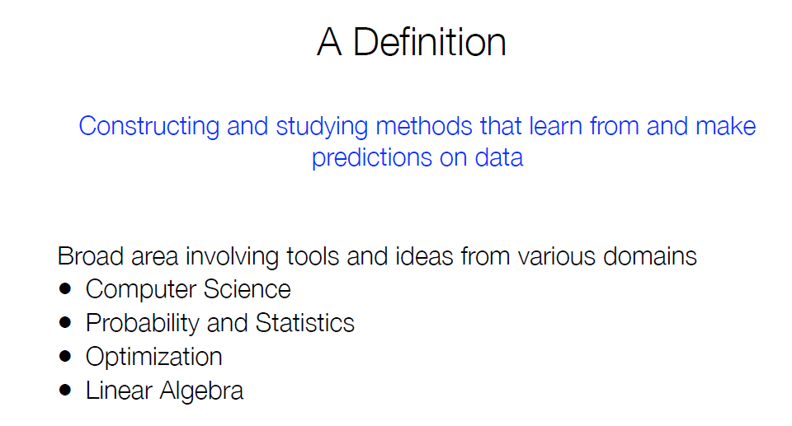
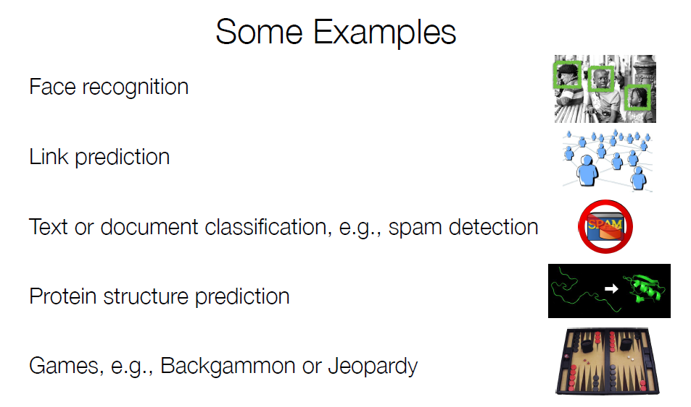
What is Machine Learning?

Slide 20
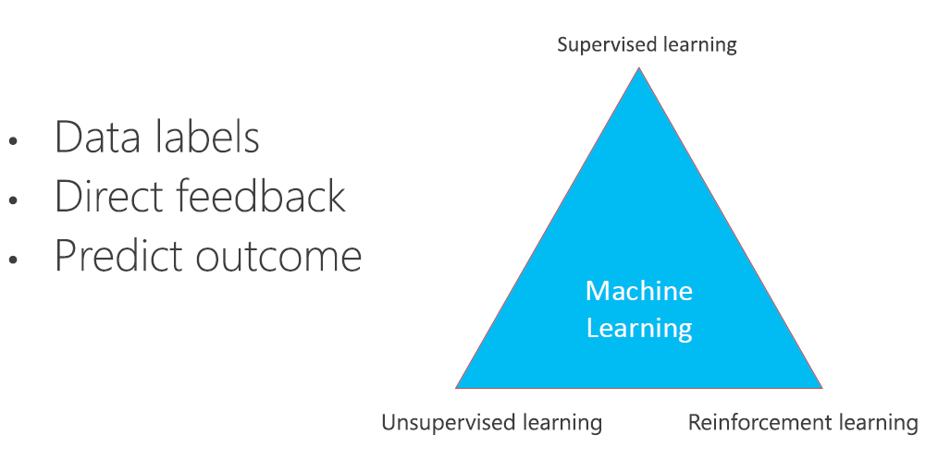
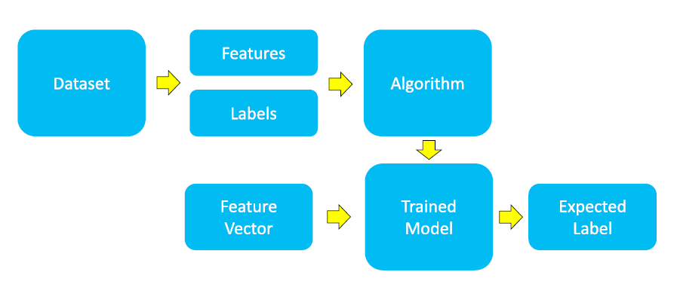
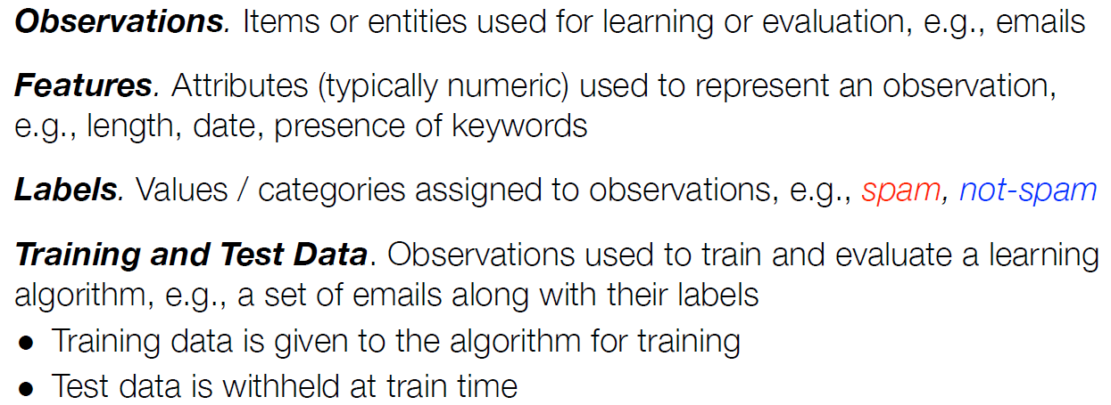
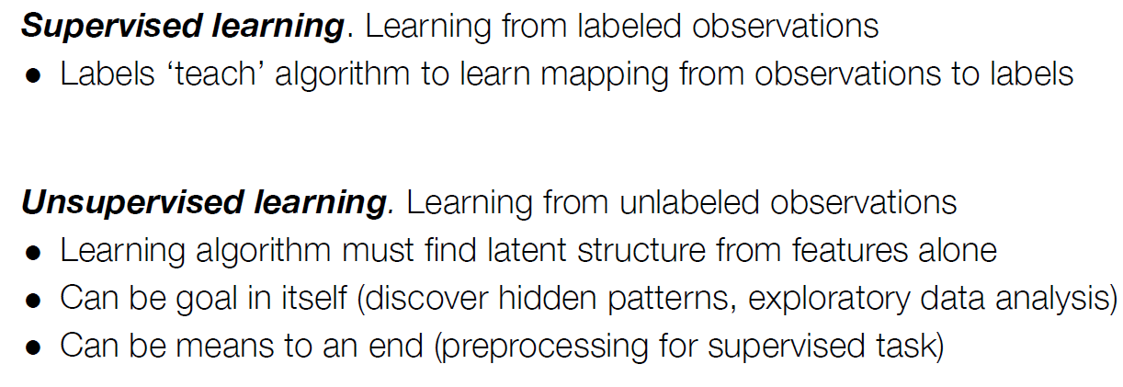
How does Machine Learning work?

Slide 21
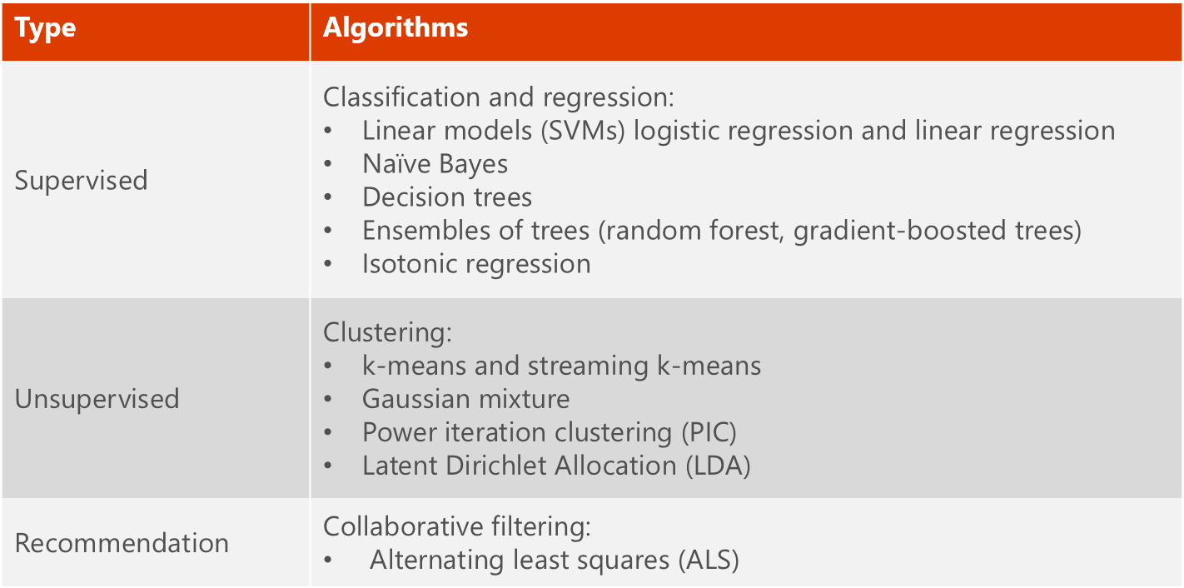
What is MLlib?
MLlib is a collection of machine learning algorithms optimized to run in a parallel, distributed manner on Spark clusters.
MLlib helps lead to better performance on large data sets.
MLlib integrates seamlessly with other Spark components.
MLlib applications are developed in Java, Scala, and Python.

Slide 22
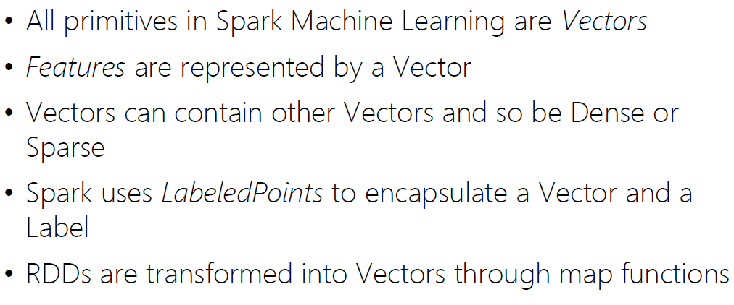
How to.. Machine Learning in Apache Spark?

Slide 23
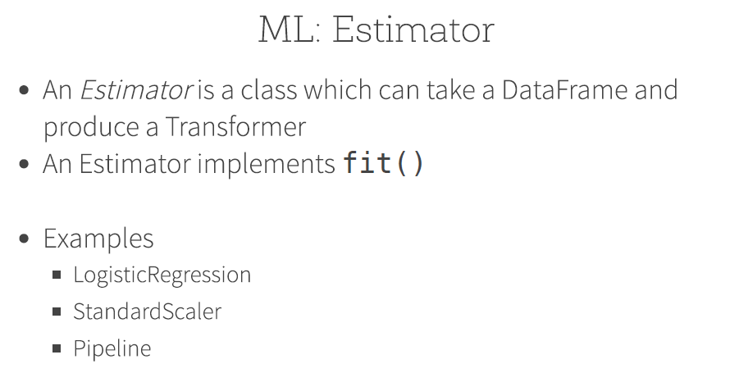
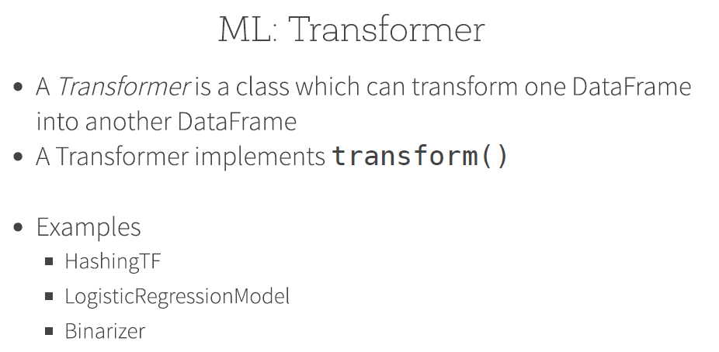
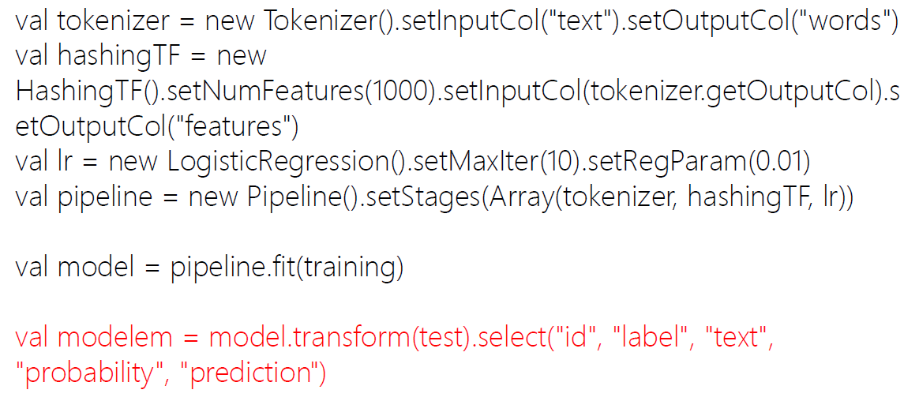
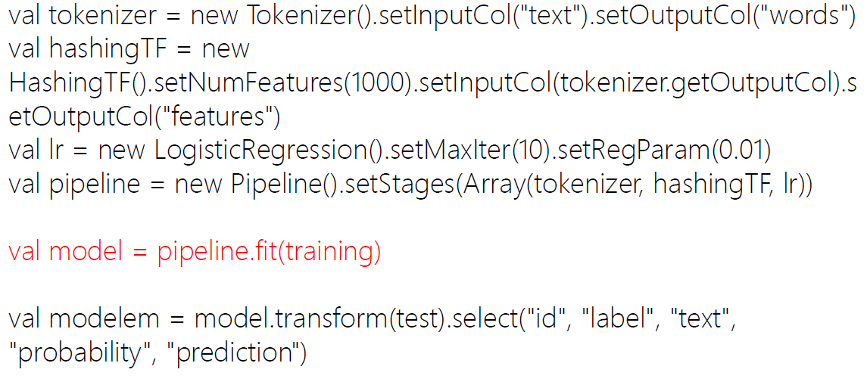
MLlib Terminology

Slide 24
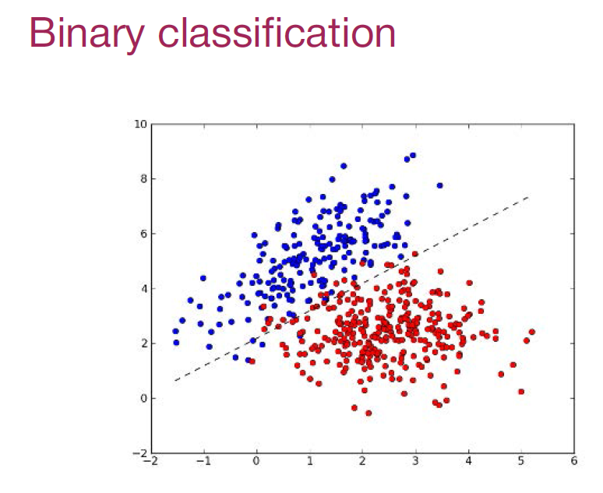
What is Classification?
To infer a function using labeled training data. The function can then be used to determine the label for a new dataset.
Algorithms
Logistic regression
Decision Trees
Neural networks
Support vector machines
Naïve Bayes
Examples (telecommunication co.)
Churn: Customers who have an inclination to switch to a different telecommunication provider.
Propensity to Buy: Customers willing to buy new products or services.
Upselling: Customers willing to buy upgraded services or add-ons.

Slide 25
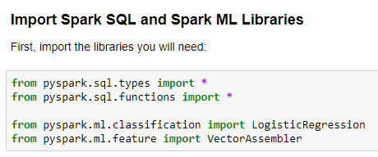
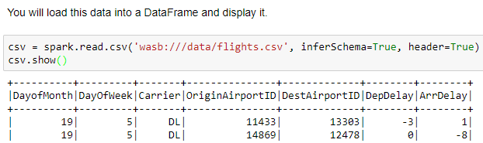
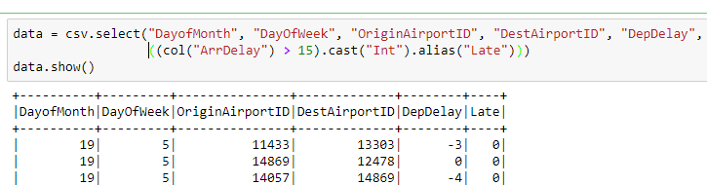
Example: Classification I
Step 2: Load Source Data
Step 3: Prepare the Data

Slide 26
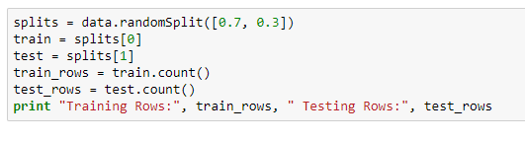
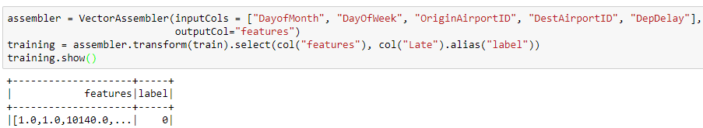

Example: Classification II
Step 4: Split the Data
Step 5: Prepare the Training Data
Step 6: Train a Classification Model

Slide 27


Example: Classification III
Step 7: Prepare the Testing Data
Step 8: Test the Model

Slide 28


What is Regression?
Regression techniques are used to predict response variables with numerical outcomes
E.g., predicting the miles per gallon of a car or predicting the temperature of a city.
The input variables may be numeric or categorical. However, the output (or response variable) is numeric.

Slide 29



Example: Regression I
Step 2: Load Source Data
Step 3: Prepare the Data

Slide 30



Example: Regression II
Step 4: Split the Data
Step 5: Prepare the Training Data
Step 6: Train a Regression Model

Slide 31


Example: Regression III
Step 7: Prepare the Testing Data
Step 8: Test the Model

Slide 32



What is Pipeline?

Slide 33



Example: Pipeline
Step 1: Define the Pipeline
Step 2: Run the Pipeline as an Estimator
Step 3: Test the Pipeline Model

Slide 34
What is Text Analysis?
85-90 percent of all corporate data is in some kind of unstructured form (e.g., text)
Unstructured corporate data is doubling in size every 18 months.
Tapping into these information sources is not an option, but a need to stay competitive.
Answer: text mining
A semi-automated process of extracting knowledge from unstructured data sources.
a.k.a. text data mining or knowledge discovery in textual databases.

Slide 35



Example: Text Analysis
Step 2: Run the Pipeline as an Estimator
Step 3: Test the Pipeline Model

Slide 36

What is Clustering?
Clustering results may be used to
Identify natural groupings of customers.
Identify rules for assigning new cases to classes for targeting/diagnostic purposes.
Provide characterization, definition, labeling of populations.
Decrease the size and complexity of problems for other data mining methods.
Identify outliers in a specific domain (e.g., rare-event detection)
Used for automatic identification of natural groupings of things.
Part of the machine-learning family.
Employ unsupervised learning.
Learns the clusters of things from past data, then assigns new instances.
There is not an output variable.
Also known as segmentation.

Slide 37



Example: Clustering
Step 1: Create the K-Means Model
Step 2: Get the Cluster Centers
Step 3: Predict Clusters

Slide 38

What is Recommendation?
The Netflix contest: Build a better recommender system from Netflix data
Use the crowd’s votes to complete the missing entries
Aliens
Dark Knight
Cars
Bug’s Life
Carmen
Joseph
Leonore
Esmerelda

Slide 39



Example: Recommendation I

Slide 40


Example: Recommendation II

Slide 41

Questions

